Slide 1

Module 9: Customizing Siebel Analytics Web User Interface
0/5
Analytics: Advanced Application Developer

Slide 2
Module Objectives
After completing this module you will be able to:
  Customize Siebel Analytics Web User Interface using cascading style sheets
  Customize Siebel Analytics Web User Interface using XML message files
Why you need to know:
  An understanding of these topics will improve your ability to customize Siebel Analytics user interface elements and appearance and enable you to "brand" the look and feel of Siebel Analytics according to a business' specific needs

Slide 3
Customizing Siebel Analytics Web User Interface
Customization of user interface elements and appearance is accomplished by modifying
  Styles and skins
    Styles impact appearance of dashboards
    Skins impact appearance of non-dashboard components, like Siebel Answers, Siebel Delivers, and Siebel Analytics Web Administration
  XML message files
Customization of user interface elements and appearance is not accomplished through use of JavaScript
  Do not modify JavaScript files in installation folders
  Objects and methods in these scripts may change and files may be replaced during upgrades

Slide 4
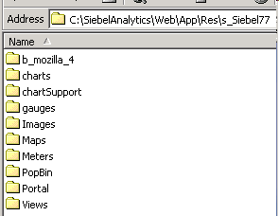
Modifying Web User Interface Styles
Create a custom user interface for dashboards by modifying Siebel cascading style sheet (CSS) files and images stored in the default installation directory:
\\SiebelAnalytics\Web\App\Res\s_Siebel77

Slide 5
Working with CSS Files to Modify Styles
There are three CSS files that affect most of the dashboard user interface:
  PortalBanner.css
    Influences overall appearance of dashboard's top section, including dashboard names, links, and so forth
  PortalContent.css
    Influences overall appearance of a dashboard's main content area, including background color of dashboard page, page tab color, and so forth
  Views.css
    Influences appearance of each of the Siebel Analytics request view (Title, Table, Pivot Table, Chart, Narrative, and so forth)
Located in \\SiebelAnalytics\Web\App\Res\s_Siebel77\b_mozilla_4

Slide 6
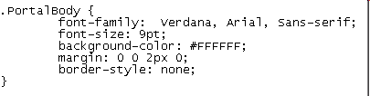
Cascading Style Sheet Example
Open PortalContent.css file located in \\SiebelAnalytics\Web\App\Res\s_Siebel77\b_mozilla_4
PortalBody class determines appearance of dashboard page
Style sheet class
Modify to change dashboard page appearance

Slide 7

Creating a Custom Dashboard Style
Best practice is to copy default s_Siebel77 folder, paste to data directory, and rename
  Copying to data directory prevents customized CSS files and images from being overwritten during upgrade
1. Copy default s_Siebel77 folder
\\SiebelAnalytics\Web\App\Res\s_Siebel77
2. Paste into data directory and rename
\\SiebelAnalyticsData\Web\Res\s_MyStyle
3. Make and save modifications
4. Restart Siebel Analytics Web service

Slide 8
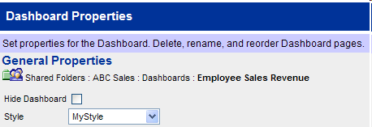
Applying a Custom Dashboard Style
Custom style becomes available in Dashboard Properties screen after Siebel Analytics Web service is restarted
Select custom style from Style drop-down list

Slide 9
Customizing Non-Dashboard Components
Non-dashboard components include Siebel Answers, Siebel Delivers, and Siebel Analytics Web Administration
CSS files and images for these components are stored in \\SiebelAnalytics\Web\App\Res\sk_Siebel77
Use same logic described for dashboard styles to make modifications to non-dashboard components' skins
Non-dashboard components are controlled globally; users cannot toggle between skins as they can with dashboard styles

Slide 10
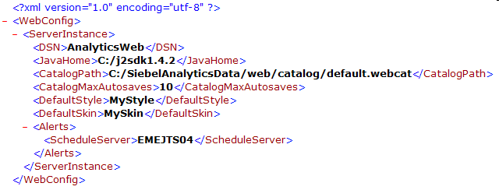
Specifying Defaults for Styles and Skins
Use instanceconfig.xml to specify default styles and skins
  Identifies style and skin folders to use in \Web\App\Res when users select Default style option in Dashboard Properties
  Omit s_ and sk_ from entries
    For example, if custom style folder is called s_MyStyle, enter as MyStyle
Default style
Default skin

Slide 11
XML Message Files
Used to customize text elements that appear in Siebel Answers, Siebel Delivers, and dashboard pages:
  Content of text strings
  Text for prompts
  Names of links and buttons
  Error and informational messages

Slide 12
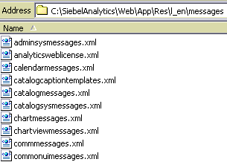
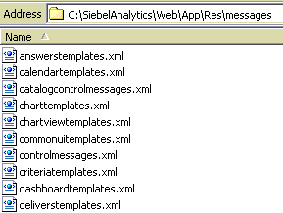
XML Message Files: Location
Language-specific messages are located in language-specific folders
  \\SiebelAnalytics\Web\App\Res\l_xx\Messages, where xx is the language identifier for selected locale (for example, l_en for English-USA)
Language-independent messages are located in \\SiebelAnalytics\Web\App\Res\Messages
Language-specific
Language-independent

Slide 13
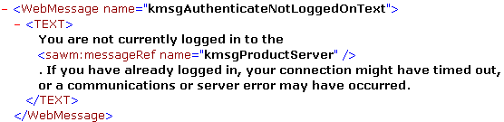
XML Message Files: Structure
Name of message file indicates kind of content that it holds
  For example, LogonMessages.xml contains message content related to logging on and off
WebMessage name tags define message names
  Tags are called message identifiers
messageRef name tag references content of another message
Message start
WebMessage name tag
Message name
Customizable text between TEXT tags
References content of another message
Name of server retrieved from kmsgProductServer message identifier
Message end

Slide 14

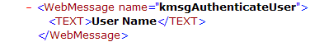


Customizing XML Messages
Change the text of unprotected messages
  Some messages contain copyright or product information and are protected and cannot be changed
Place customized file(s) in CustomMessages folder
  Create many customized XML files or just one that holds all customized messages
1. Create custom XML message file
2. Change text of unprotected messages
3. Create folder named CustomMessages and place in desired directory
4. Place custom message files in CustomMessages folder
5. Restart Siebel Analytics Web

Slide 15
Resolution of XML Message Name Tags
During initialization, Analytics Web Server replaces WebMessage name default text with equivalently named tags in customized XML file(s), based on following precedence order, highest to lowest:
\\SiebelAnalyticsData\Web\Res\l_xx\CustomMessages (custom language-specific messages)
\\SiebelAnalyticsData\Web\Res\l_en\CustomMessages (messages default to l_en if language-specific version not found)
\\SiebelAnalyticsData\Web\Res\CustomMessages (custom language-independent messages)
\\SiebelAnalytics\Web\Res\l_xx\Messages (default language-specific messages)
\\SiebelAnalytics\Web\Res\Messages (default language-independent messages)

Slide 16
Summary
This module showed you how to:
  Customize Siebel Analytics Web User Interface using cascading style sheets
  Customize Siebel Analytics Web User Interface using XML message files

Slide 17
Lab
In the lab you will:
  Customize Siebel Analytics Web User Interface using cascading style sheets
  Customize Siebel Analytics Web User Interface using XML message files

